Slide 1

Acoustics 2017 Boston | ASA
Automatic Classification of Humpback Whale Social Calls
Irina Tolkova¹ and Lisa Bauer²,
Antonella Wilby³, Ryan Kastner³, Kerri D. Seger⁴
¹Applied Math and Computer Science Departments, University of Washington, WA, USA
²Department of Computer Science, Johns Hopkins University, MD, USA
³Jacobs School of Engineering, University of California San Diego, CA, USA
⁴School of Marine Science and Ocean Engineering, University of New Hampshire, NH, USA
Notes:
Hello! I am Irina Tolkova, and I will be presenting a study on the Automatic Classification of Humpback Whale Social Calls.
I’d like to thank my co-first-author, Lisa Bauer, who unfortunately could not be here, as well as the other co-authors of this work.

Slide 2
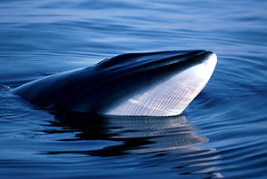
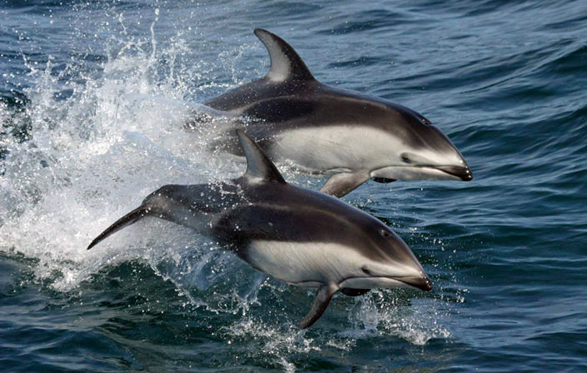
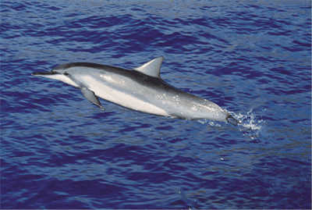
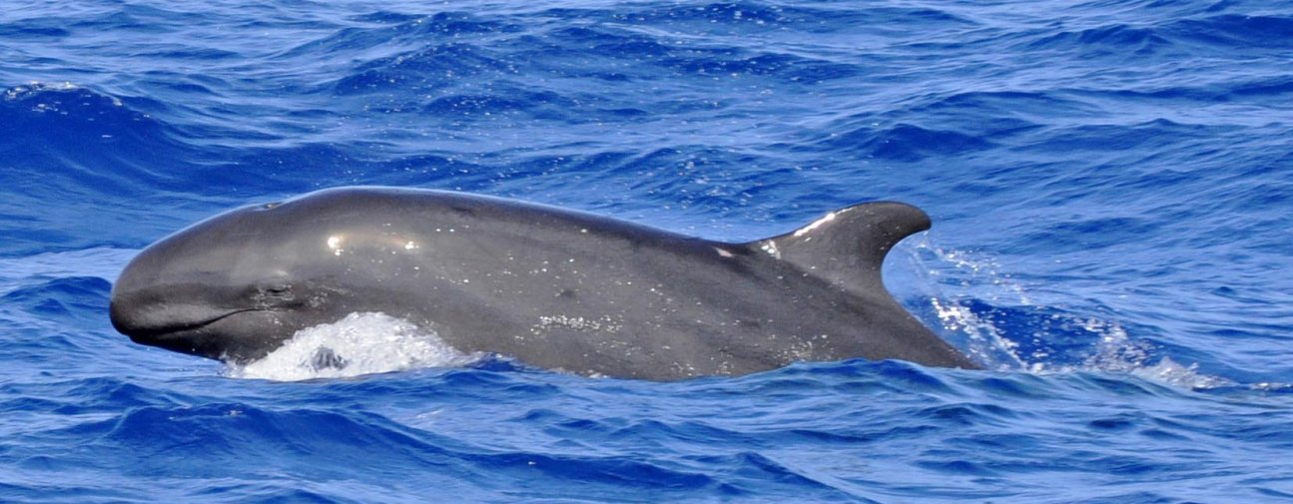
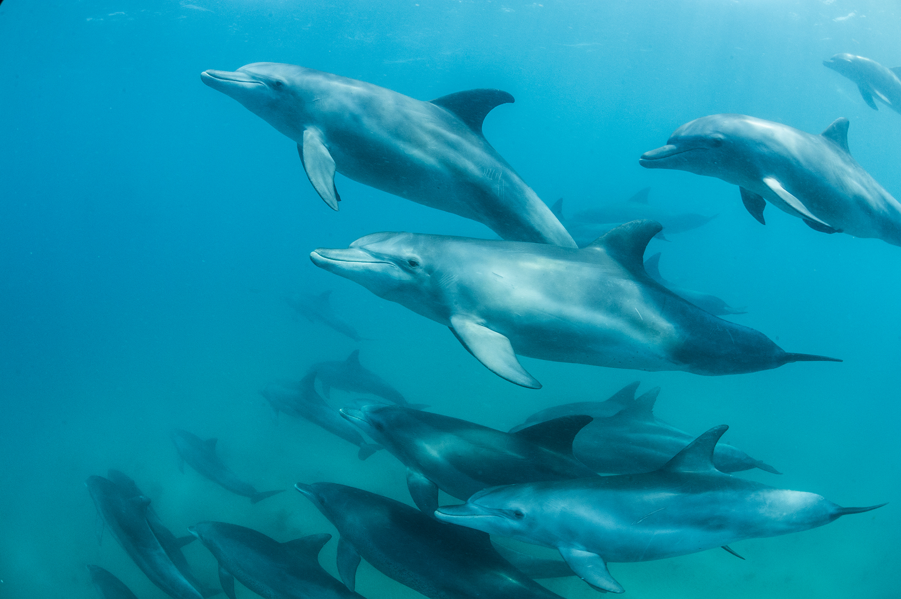
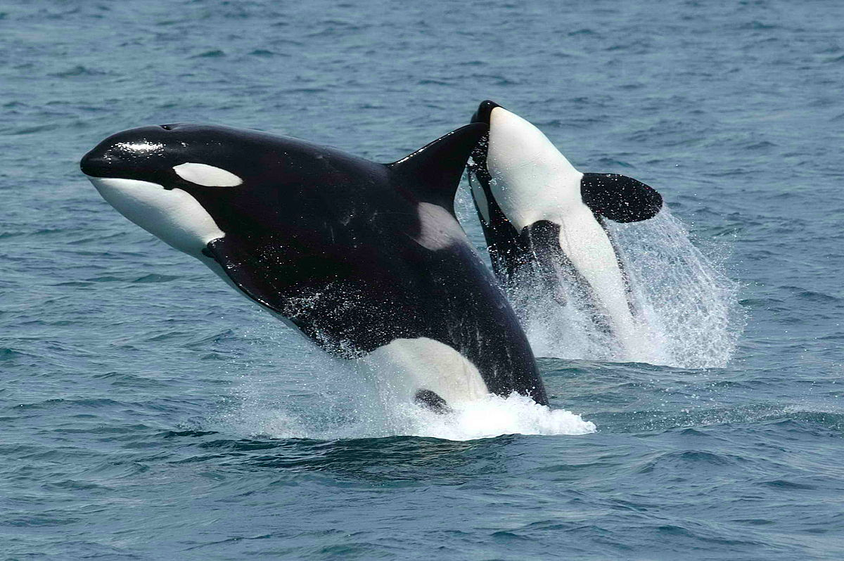
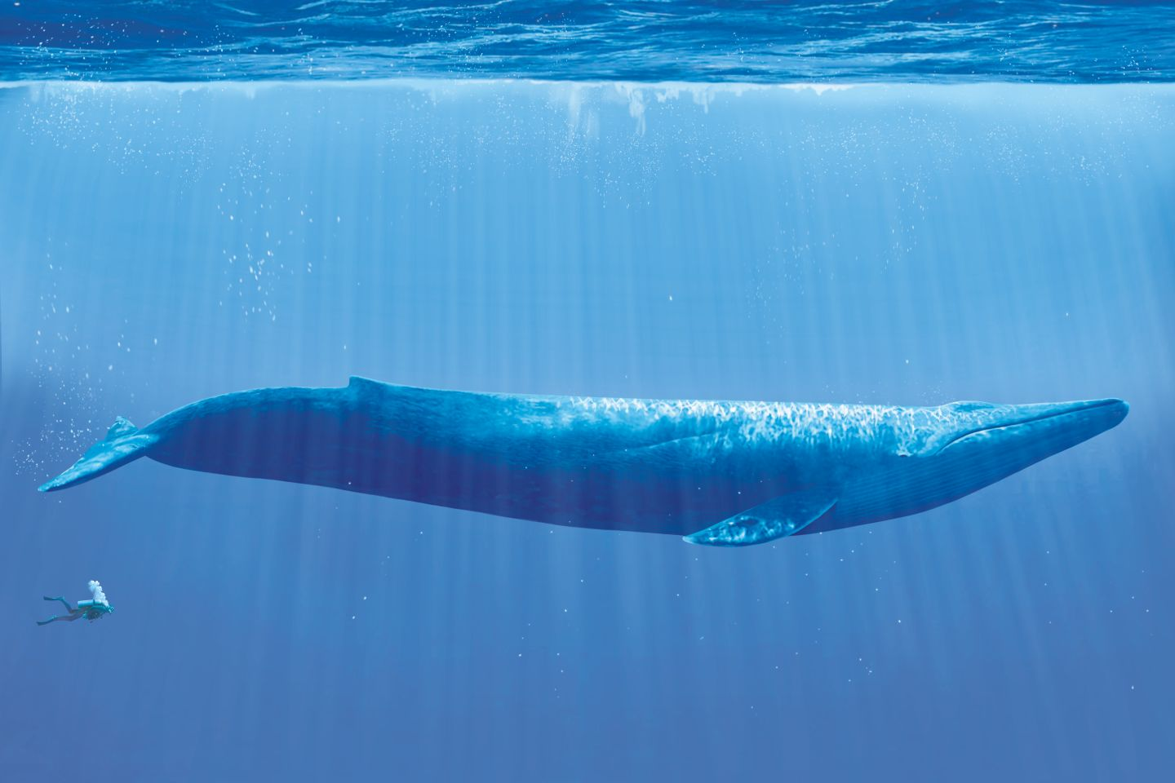
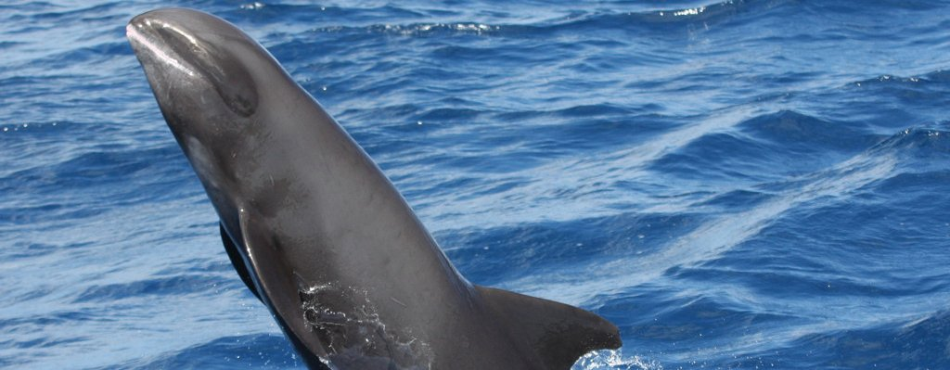
Cetacean Bioacoustics
Notes:
Bioacoustics has become very popular as a field, and has been applied as a study technique for a variety of cetacean species, ranging from blue whales to dolphins.
The main objective of these studies is to _________....

Slide 3
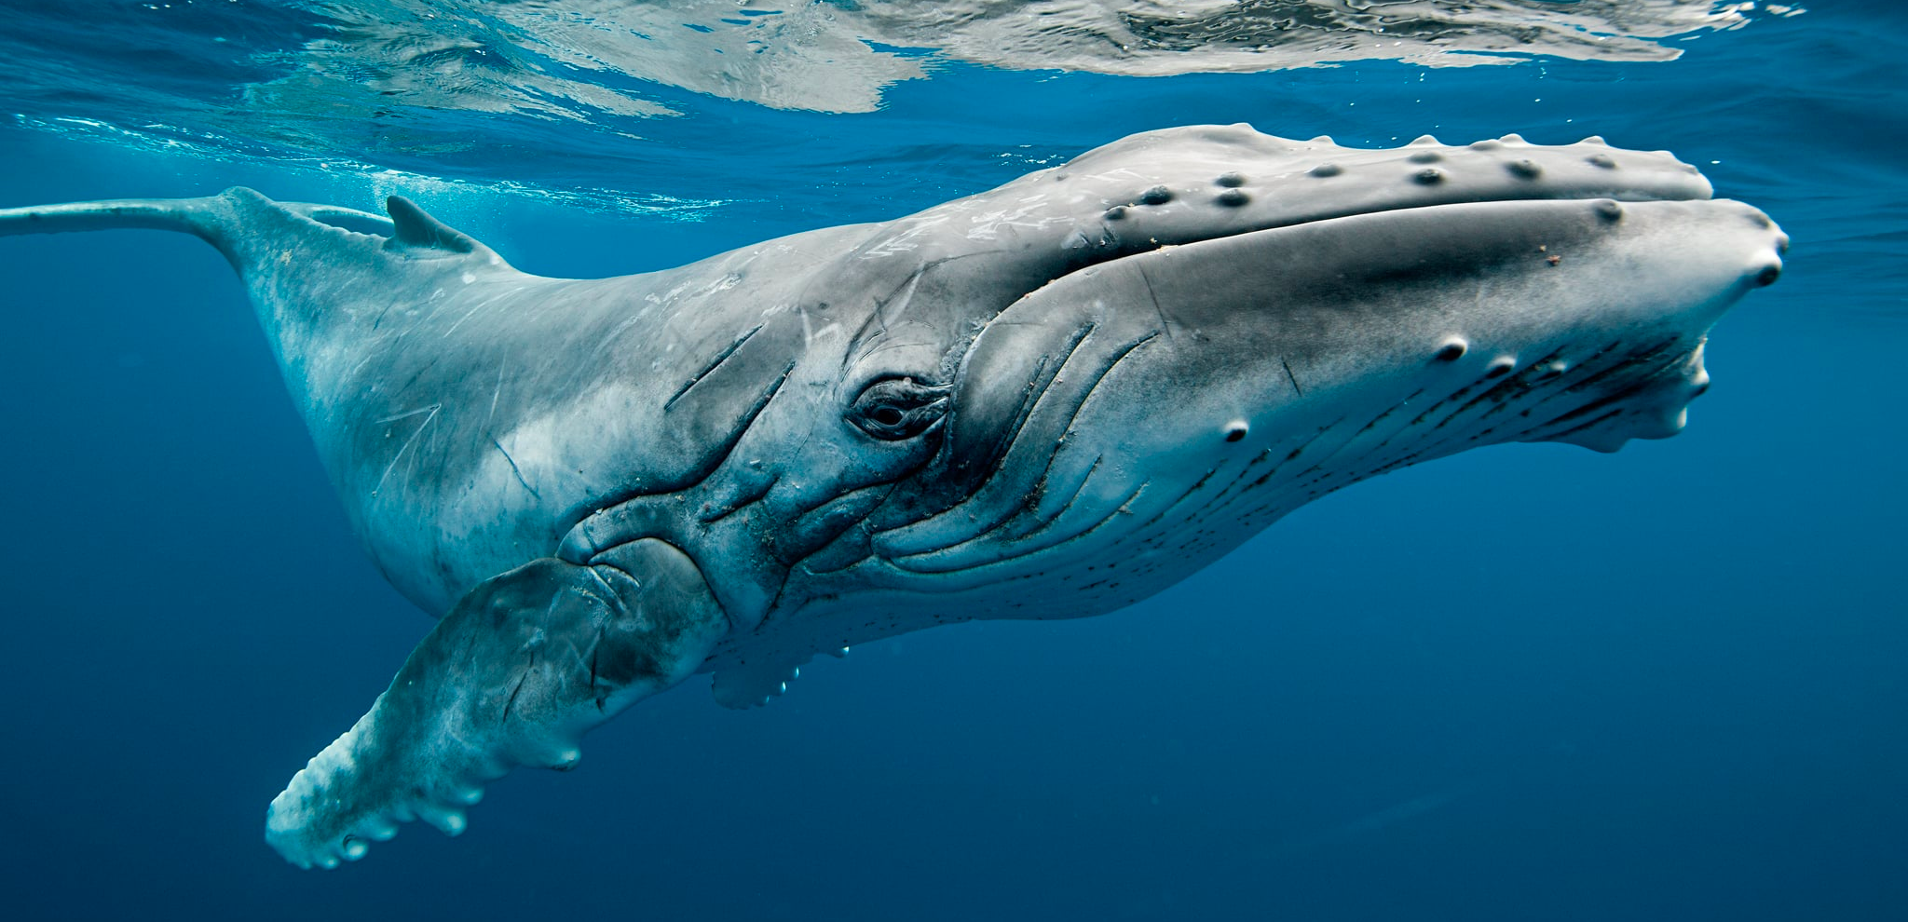
Humpback Whale Bioacoustics
While manual analysis has been applied to a variety of species, studies in automated detection of humpback whale social calls have been limited. This is largely because their social call repertoire is very varied, both in duration and frequency, so most classification work is manual.
Notes:
notes:
-- one slide: discuss the various mammal species that have been studied (photos, etc)
-- cite Marie Roch
-- second slide: discuss humpback whales, social calls
-- include variety of humpback whale calls and spectrograms (with stats)

Slide 4
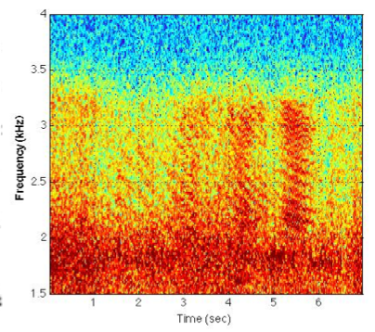
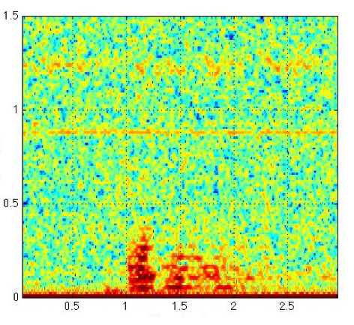
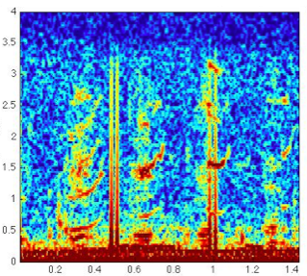
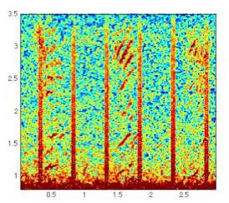
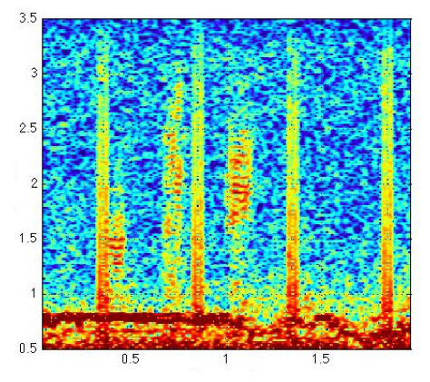
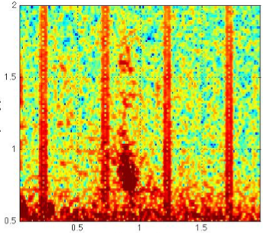
Humpback Whale Social Sound Catalog
Growl
Grunt-grumble
Pulses
Ascending moan
Squelch
Swop

Slide 5
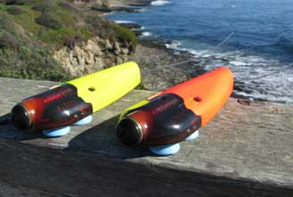
Data Collection
The data for this project was collected by Dr. Kerri Seger and Dr. Aaron Thode of the Scripps Institute of Oceanography. Acousonde acoustic tags were used for recording underwater audio.
Notes:
Our project started with acoustic data for humpback whale calls.
The data was collected by Dr. Kerri Seger and Dr. Aaron Thode of the Scripps Institution of Oceanography. They deployed Acousonde acoustic tags, a type of underwater hydrophone produced by Greeneridge Sciences specifically for bioacoustics studies. These are interesting because they attach by suction-cup onto a marine mammal’s back. The data is only retrieved after they fall off and float to the surface. The antenna you see is a VHF transmitter, which allows the users to find the tag once it surfaces.

Slide 6
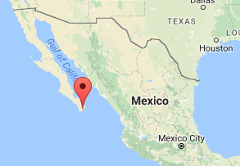
Data Collection
The data for this project was collected by Dr. Kerri Seger and Dr. Aaron Thode of the Scripps Institute of Oceanography. Acousonde acoustic tags were used for recording underwater audio.
The tags were deployed in Los Cabos, Mexico.
This region falls within a migration route, and is also a breeding ground of the North Pacific humpback whale subpopulation.
Notes:
They were deployed in Los Cabos, Mexico. This is on the tip of Baja California, and was a location where we expected a large number of humpback whales, as it is both a breeding ground and on the migration route.

Slide 7
Data Collection
The data for this project was collected by Dr. Kerri Seger and Dr. Aaron Thode of the Scripps Institute of Oceanography. Acousonde acoustic tags were used for recording underwater audio.
The tags were deployed in Los Cabos, Mexico.
This region falls within a migration route, and is also a breeding ground of the North Pacific humpback whale subpopulation.
Acoustic data was collected during February and March of 2014 and 2015, resulting in just under 70 hours of recordings. These recordings were manually labeled for whale calls. Each call was classified into a call type category.
Notes:
The data was collected in the spring, over two years – 2014 and 2015. There is a lot of data – almost 70 hours.
Moreover, after the data was collected, it was manually scanned for calls by biologists, and then classified and labeled.
It is worth mentioning that most of the data is just underwater recording – flow noise, bubbles, other sounds – with comparatively rare call occurrences.

Slide 8
Project Goal
The overall goal of this project is to create an automatic system that would detect and classify humpback whale social calls.
There are two main steps to this project:
signal processing
machine learning / classification
Notes:
We were interested in trying to create a system to be able to automatically do this detection and classification.
This project split naturally into two steps. The first was signal processing, to clean and process the data.

Slide 9
Project Goal
The overall goal of this project is to create an automatic system that would detect and classify humpback whale social calls.
There are two main steps to this project:
signal processing
machine learning / classification
original data
labels

Slide 10
Project Goal
The overall goal of this project is to create an automatic system that would detect and classify humpback whale social calls.
There are two main steps to this project:
signal processing
machine learning / classification
original data
processed data
labels
labels
Notes:
So this is the signal processing step. The next step was to train a classifier…

Slide 11
Project Goal
The overall goal of this project is to create an automatic system that would detect and classify humpback whale social calls.
There are two main steps to this project:
signal processing
machine learning / classification
original data
processed data
classifier
labels
labels
Notes:
And the eventual purpose of a classifier is that…

Slide 12
Project Goal
The overall goal of this project is to create an automatic system that would detect and classify humpback whale social calls.
There are two main steps to this project:
signal processing
machine learning / classification
new data
original data
processed data
classifier
labels
labels
automatic labels
Notes:
… someday, if the system is robust, we would be able to take new data and automatically generate labels.
There were a lot of difficulties that come up with creating this system… I’ll get into more of them later, but for now, lets look at the signal processing .

Slide 13
Spectrogram Processing: Pings
Here is a 10-second spectrogram of the recordings:
Notes:
If we take a clean, relatively quiet 10-second sample of the data and make a spectrogram, it might look like this:

Slide 14
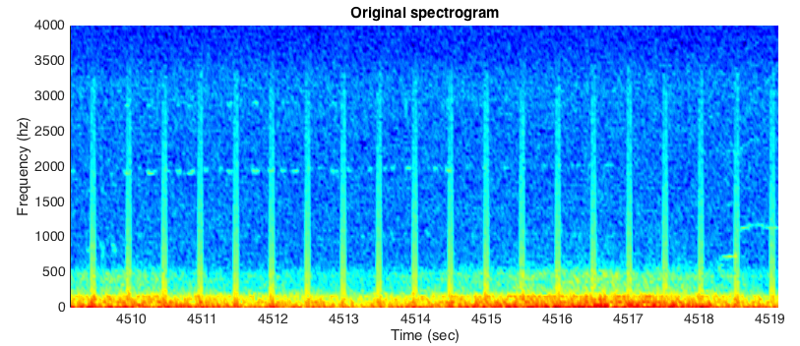
Spectrogram Processing: Pings
Here is a 10-second spectrogram of the recordings:
Notes:
There are calls here, and they are “low yaps”. However, they are these very small points at about 2 kHz.
These white-noise-like periodic bands that you see are actually an effect of the VHF transmitter.
After (unsuccessfully) attempting to remove them through cross-correlation or auto-correlation, we decided to just cut them out.
This results in a set of spectrogram windows that look like this:

Slide 15
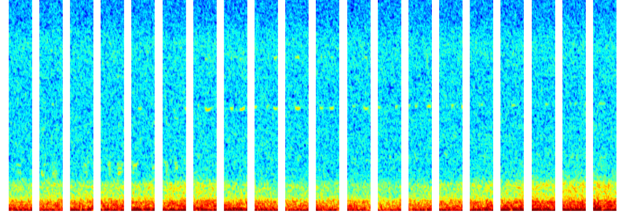
Spectrogram Processing: Pings
Here is a 10-second spectrogram of the recordings:
Using periodicity, remove the pings:
Notes:
You can see that this is slightly shifted over, but the calls are still there.

Slide 16
Spectrogram Processing: Background
Is there a way to isolate the foreground of this spectrogram?
Notes:
Here is the spectrogram again.
Our next objective is to try to isolate the foreground, and reduce the impact of the background.
Our approach was to use PCA, or Principal Component Analysis.
This is a method for matrix decomposition. It is used for data analysis because is finds the optimal basis in which to represent that data.
In this case, if we take many of these windows and apply PCA, we find that the four most important components look like this:

Slide 17
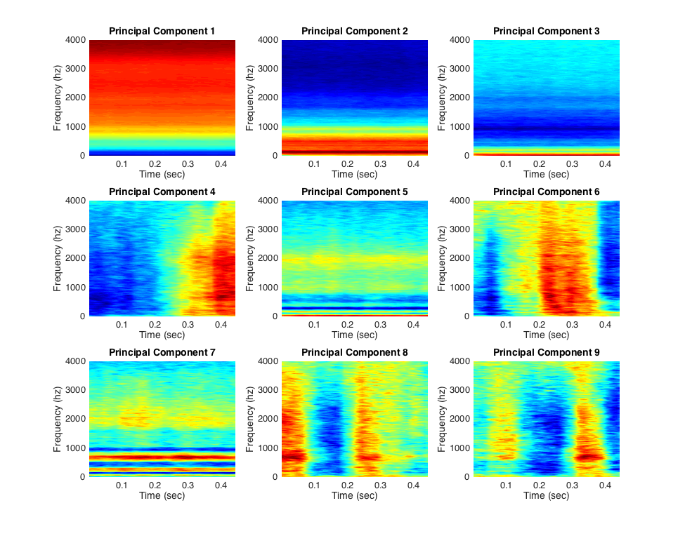
Spectrogram Processing: Background
Is there a way to isolate the foreground of this spectrogram?
Principal component analysis (PCA) is a method for calculating the optimal basis of a matrix. In this case, the principal components are:
Notes:
Each of the windows above can be represented as a linear combination of the principal components.
But we can see that the three most significant components are all time-invariant, and can be thought of as a representation of the background.
So, we can try to subtract these from the data.

Slide 18
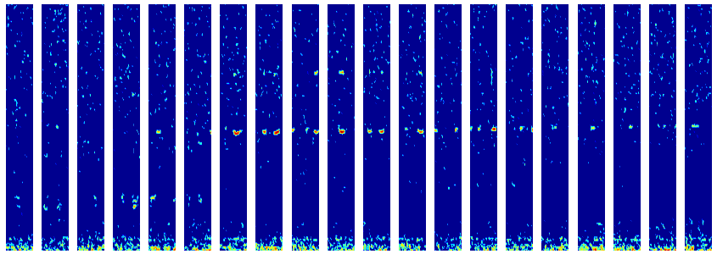
Spectrogram Processing: Background
For each window of the spectrogram, remove the contribution (projection) of the first three principal components. The spectrograms are now:
Notes:
We can take the projection of each window onto these modes to find the principal coefficients.
Then, we subtract the contribution of each coefficient and threshold everything below a set value to 0. This is the result.
As you can see, the calls are still visible, and the background is reduced.

Slide 19
Spectrogram Processing: Background
Use a connected-components approach to further process the images:
Notes:
Now, we apply some more processing to make the spectrogram look cleaner.
We removed any particles that had fewer than a set number of points, and that were below 250 Hz.

Slide 20
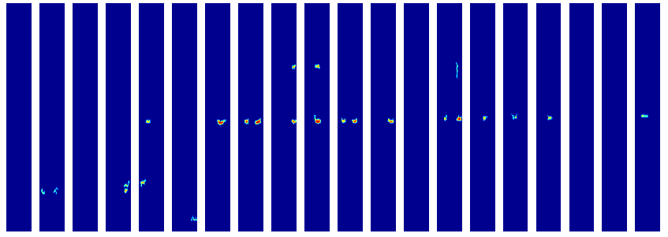
Spectrogram Processing: Background
Use a connected-components approach to further process the images:
Notes:
This is the result.

Slide 21
Spectrogram Processing: Cleaning
Before and after:
These processed spectrograms are input to the machine learning step.
Notes:
Here is the before and after.

Slide 22
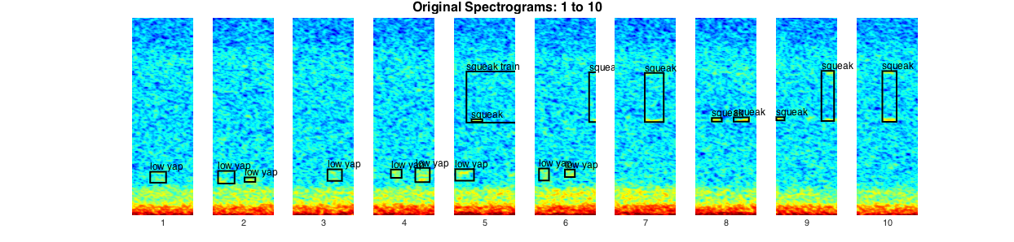
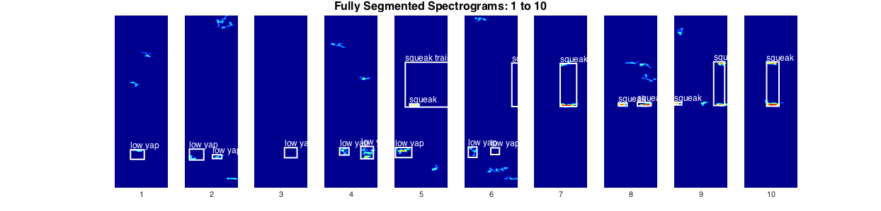
A closer look at the data…
Notes:
Here is a very clean example of the processing on a sample of the data filled with calls.

Slide 23
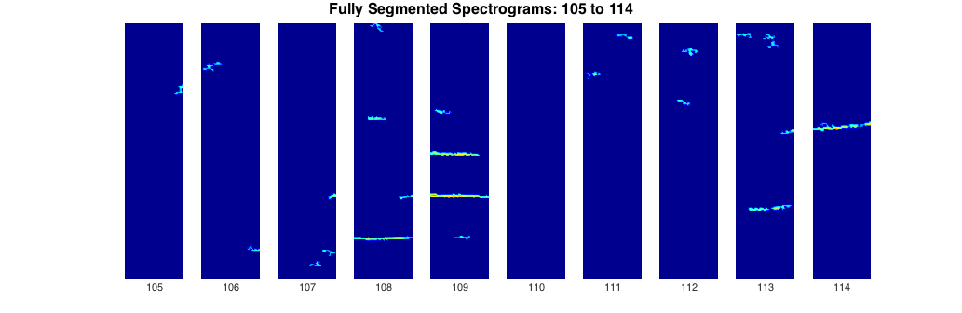
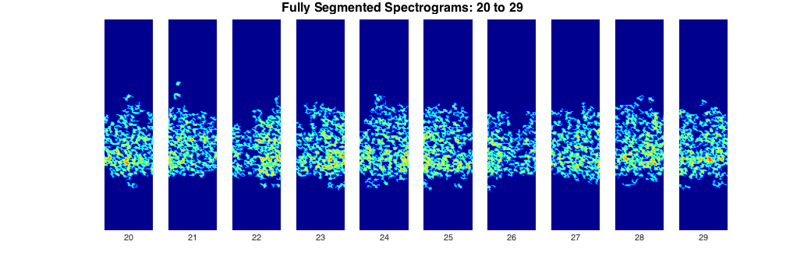
Difficulty in Classification
There are many difficulties in detection and classification due to differences between calls, flow noise, noise from the tag, boat noise, and so on. This limits achievable classification accuracy.
Notes:
However, a large part of the data also looked like this… you can see boat noise and flow noise.

Slide 24
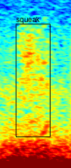
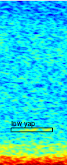
Classification Approach: SVM
We used the Support Vector Machine (SVM) classifier: a machine-learning approach for categorical classification of continuous data.
We focused on two most common call types: “squeaks” and “low yaps”
squeak
low yap
Training set: 2/3 of combined segments of five datasets
Testing set: 1/3 of combined segments of five datasets
To prioritize false positives over false negatives, we applied weights to “bias” model towards finding calls.
Notes:
We used SVMs, or Support Vector Machines, for the classification. This is a very common method for classifying continuous data into categories – in this case, to call type.

Slide 25
Classification Results
Here are the confusion matrices resulting from the classification:
 | No call | Squeak | Accuracy
No call | 172 | 14 | 0.925
Squeak | 7 | 6 | 0.462
 | No call | Low yap | Accuracy
No call | 192 | 1 | 0.995
Low yap | 3 | 3 | 0.5
These results are highly sensitive to the choice of class weights.
Classification error results from:
high-amplitude noise from other sources that can be mistaken for calls
background noise (such as flow noise) that obscures calls
very low ratio of call samples to non-call samples

Slide 26
Conclusion
All in all, this study suggested and implemented a method for automatically detecting and classifying humpback whale social calls within acoustic data.
The results have much room for improvement, but are promising for future work.
Some of the error is unavoidable, due to noise in the data as mentioned previously.
We hope that classification accuracy would increase with:
more data incorporated into the analysis
different call types incorporated into the analysis
experimentation with signal processing techniques
experimentation with classifiers, such as neural networks
“phylogenetic” categorization of calls?
Notes:
…and we hope that someday, we will be able to successfully eavesdrop on and interpret humpback whale conversations.
--transition

Slide 27









Acknowledgements
We would like to thank:
the ASA
the NSF, and specifically the REU program
our respective institutions
Greeneridge Sciences, for producing the acoustic tags
As well as:
Aaron Thode, for facilitating data collection
Alric Althoff, for fantastic mentorship during this project
Bill Burgess, for help with interpreting the data
Brooke Hawkins, for help with interpreting the data and ecological consulting

Slide 28
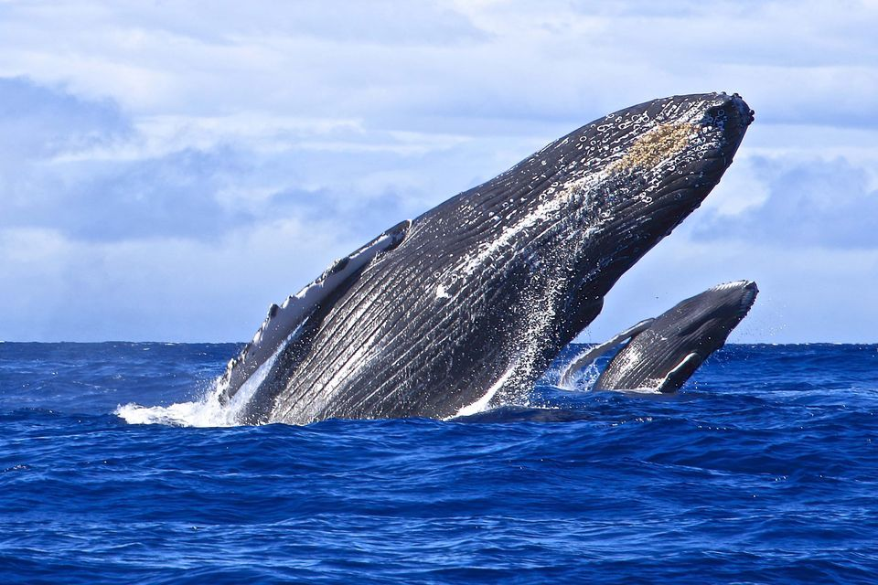
Questions?

